Slide 1

Git
Architecture and How It Stores & Processes Information
Vishwas Dabhi - 23CS01015
IIT Bhubaneswar-CSE

Slide 2




What is git ?
Distributed Version Control System (DVCS)
Used to track changes in the source code.
Helps multiple developers to collaborate and manage projects effectively.
Widely used in software development.
Free and open-source, decentralized.
Platforms like GitHub, GitLab and Bitbucket.
Created by Linus Torvalds (2005)

Slide 3
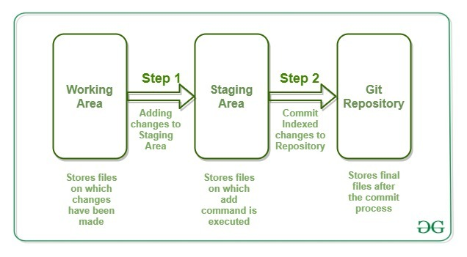
Git architecture
Working directory: The files you are currently working on. (local workspace)
Staging area: Where changes are prepared before committing. (git add)
Repository:
Local: The actual stored history of the project. (.git)
Remote: holds the shared version. (GitHub)
ref : geeksforgeeks

Slide 4
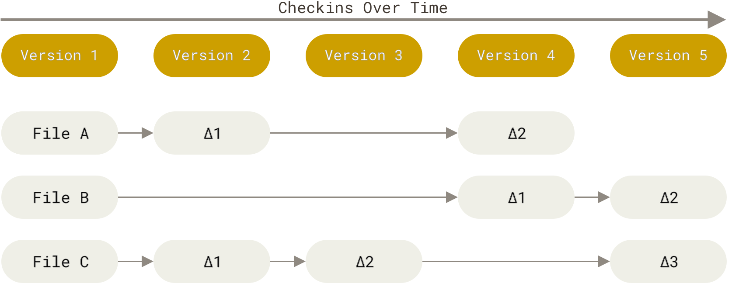
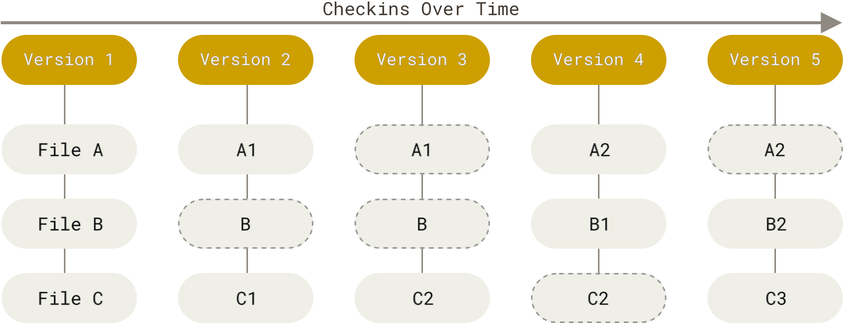
Data storage
It stores versions as snapshots instead of tracking differences.
Each commit stores a full project state,
Unchanged files are linked to previous versions instead of being duplicated.
Storing based on difference Storing as snapshots
ref : https://git-scm.com/book/en/v2/Getting-Started-What-is-Git%3F

Slide 5
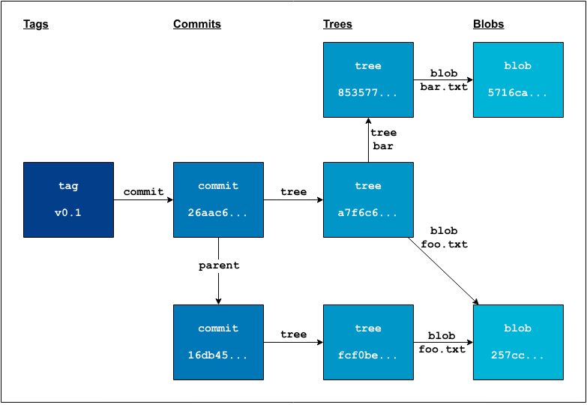
Git object database
Git stores data as four object types:
Blob: Stores file contents
Tree: Stores directory structure
Commit: Records project snapshots
Tag: References a specific commit
ref : http://retout.co.uk/2022/06/29/git-internals-and-sha1/

Slide 6
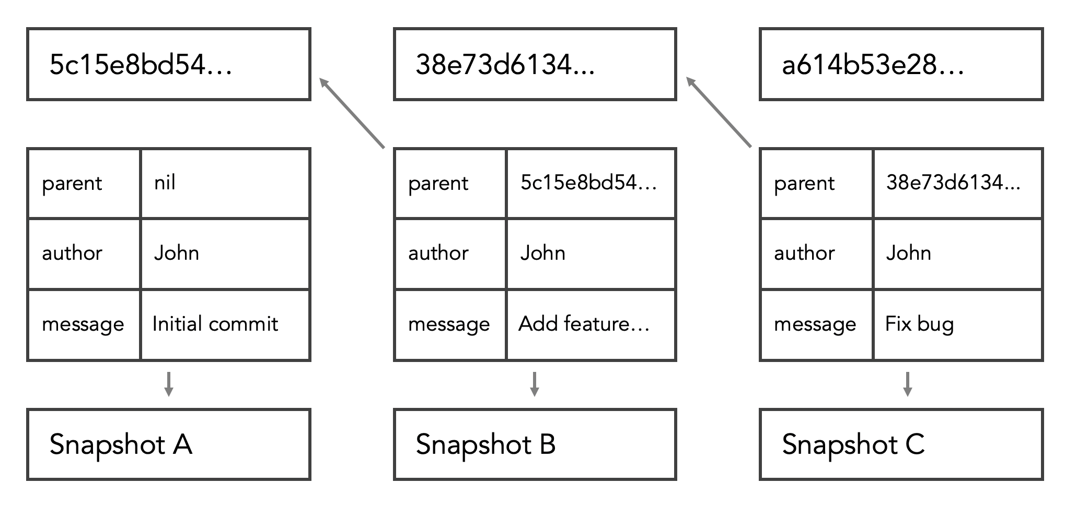
SHA-1 Hashing
Cryptographic hash function that takes an input (e.g., a file, commit, or directory in Git) and produces a 40-character hexadecimal string (160-bit hash).
Fixed length
Unique and deterministic
Irreversible
Ensures integrity
ref: https://www.designveloper.com/blog/hash-values-sha-1-in-git/

Slide 7
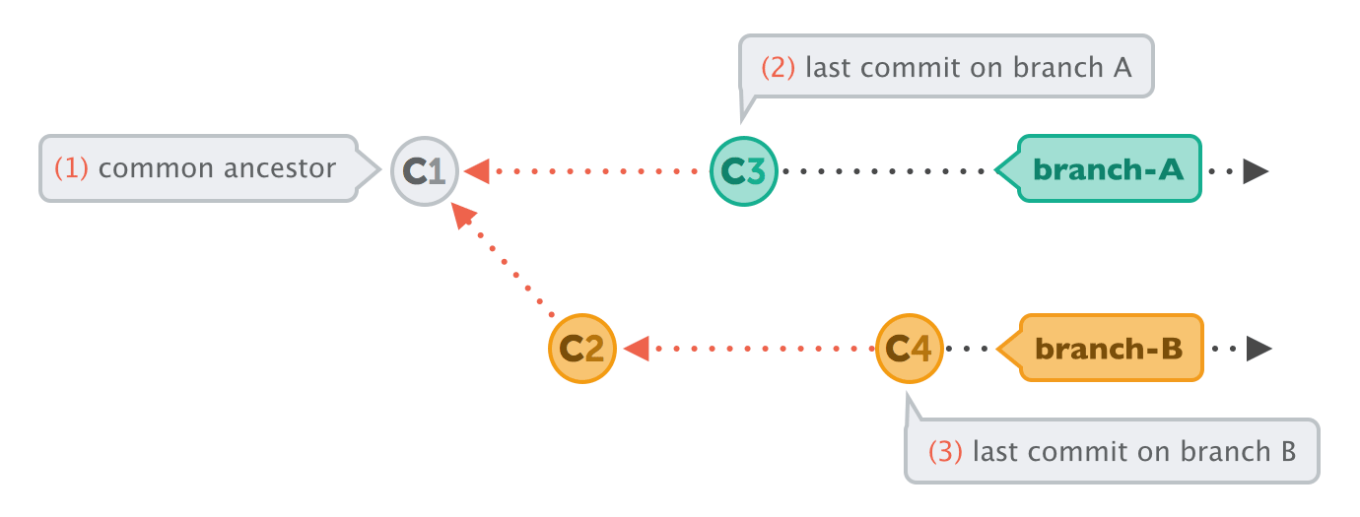
Directed Acyclic Graph (DAG)
Commits are connected in a DAG structure
Each commit references its parent(s)
Branches: pointers to commits
Tags: fixed references to commits
Red dotted arrows (backward) -> represent the parent-child relationship
Black dotted arrows (forward) -> show how branches evolved over time.
ref : google

Slide 8
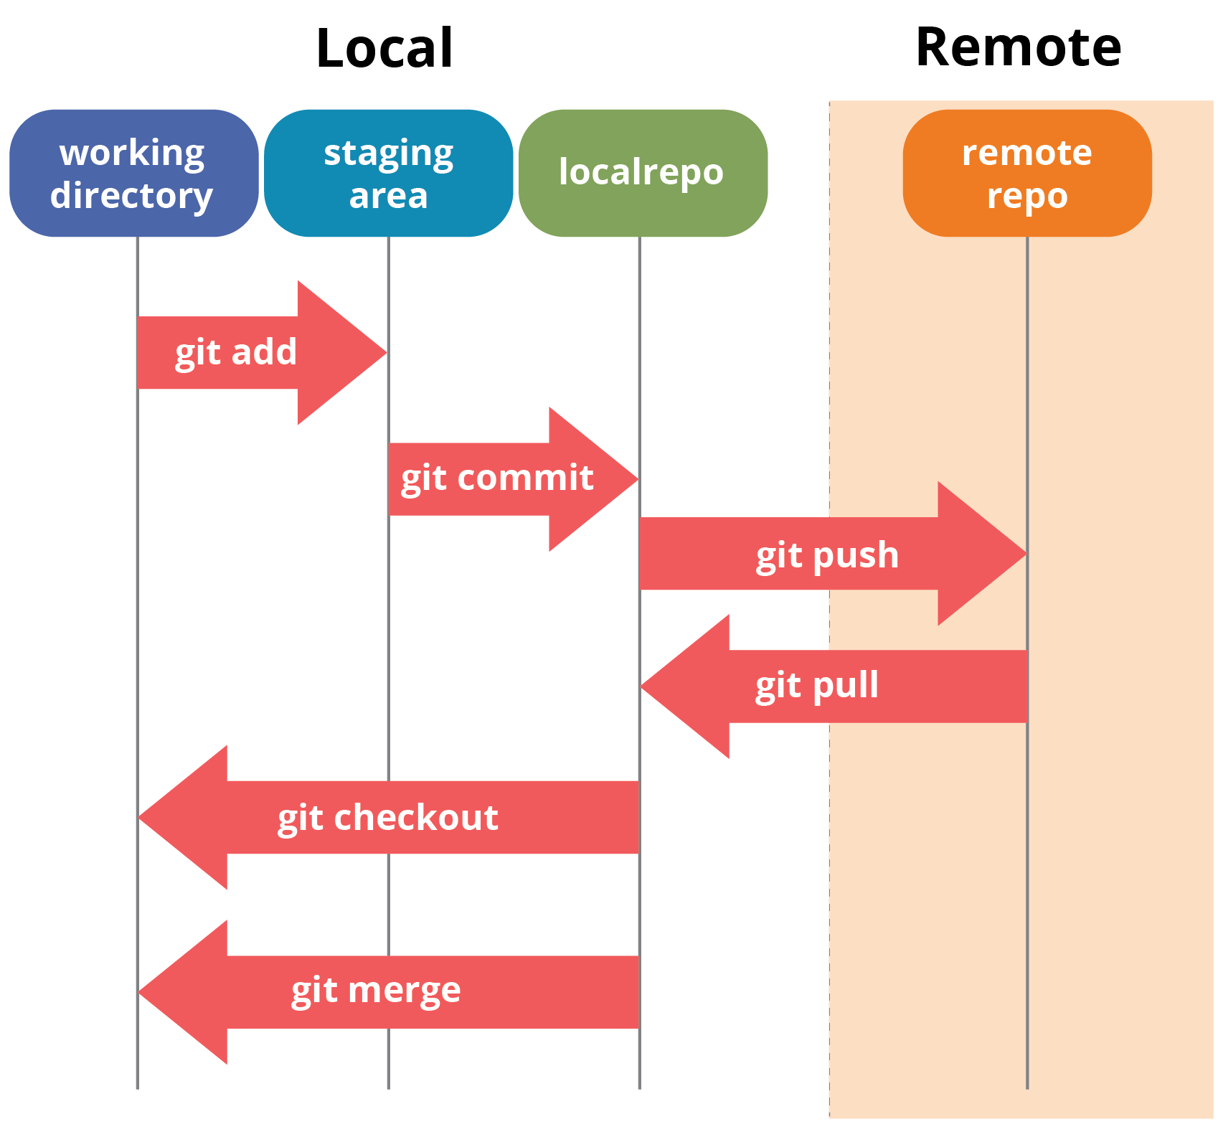
Information processing
Git add -> creates blob objects
Git commit -> creates a commit object
Git push -> Transfers object to remote repo.
Git pull -> Fetches and merges remote changes
Checkout -> switches to a different branch or commits

Slide 9
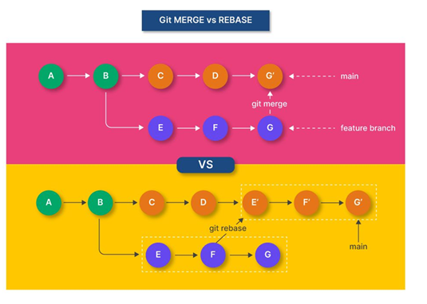
Merging vs. Rebasing
Merge –> Combines changes, creates a new commit
Rebase –> Moves commits, keeping history linear.
Merge is safer, rebase keeps history clean
ref : https://unstop.com/blog/git-rebase-vs-merge

Slide 10
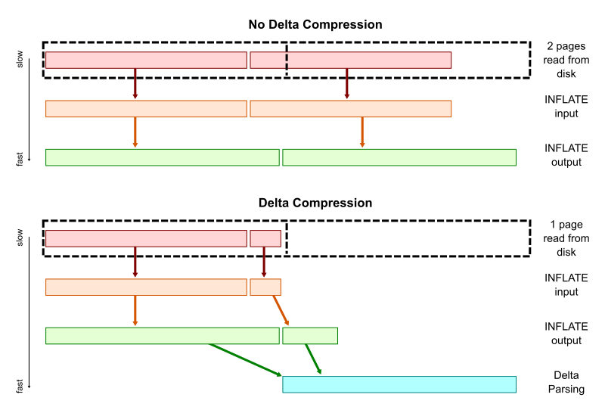
Git Internals – Packfiles
Packfiles: bundles multiple objects together to reduce space and improve performance on large projects.
Storing individual objects takes too much space
Git uses Delta compression to optimize storage and improve performance

Slide 11
Delta compression
Efficiently stores multiple versions of files by saving on the differences between them instead of full copies and reconstructs the full file when needed.
initially stores each file in a separate blob.
then git packs similar objects together using delta compression.
These are stored in Packfiles, reducing space usage.

Slide 12
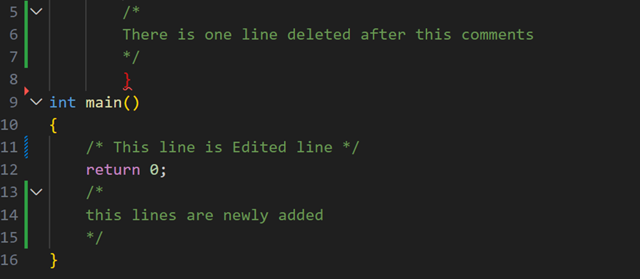
Add, change and delete

Slide 13
Garbage Collection & Optimization
Garbage collection (git gc): Removes unreachable objects
Deletes orphaned commits (not referenced by any branch)
Removes dangling blobs (unused file versions)
Cleans up abandoned references
Repacking (git repack): Compresses and stores objects
Combines loose objects into a single Packfile.
Uses delta compression to store changes efficiently
Reduces repository size and speeds up operations
Keeps repositories efficient

Slide 14
Conclusion
Git is a fast, secure, and efficient VCS
Uses snapshots, SHA-1, and DAG structures
Stores data efficiently with Packfiles & Delta Compression
Garbage collection and repacking optimize performance

Slide 15



References: ChatGPT, google, official git documentation, Stack overflow

Slide 16


